Slide 1
Hospital Management System
Created by: Erick Rotich
Supervised by: Dr Michał Antkowiak

Slide 2


Introduction
The Hospital Management System (HMS) is a system designed for any Hospital to replace their existing manual, paper based system. This system targets to provide complete solution for Hospital and Health care services.
This system can be used in any Hospital, Clinic, Diagnostics or Pathology labs for maintaining patient details and their test results.
The system integrates the entire Resources of a Hospital into One Integrated Software Application.

Slide 3


Features
Useful for;
Large, medium Hospitals and Nursing Homes
Gynaecologist, Physicians, Surgeons
Generate prescriptions fast
Both online and offline compatible
Compatible to windows 7 or higher
SMS facility

Slide 4

Benefits
Minimize hand written work from admission to discharge of patient and final billing.
Helps to minimize your repeated works and take care of the complete functionality of your hospital.
Daily collection of report.
It is a huge time saver and really facilitates proper communication among the management, and staff.

Slide 5
Modules
Statistics
Patients
Doctor
Appointments
Payments
Room Allocation
Register
Login
Contact

Slide 6
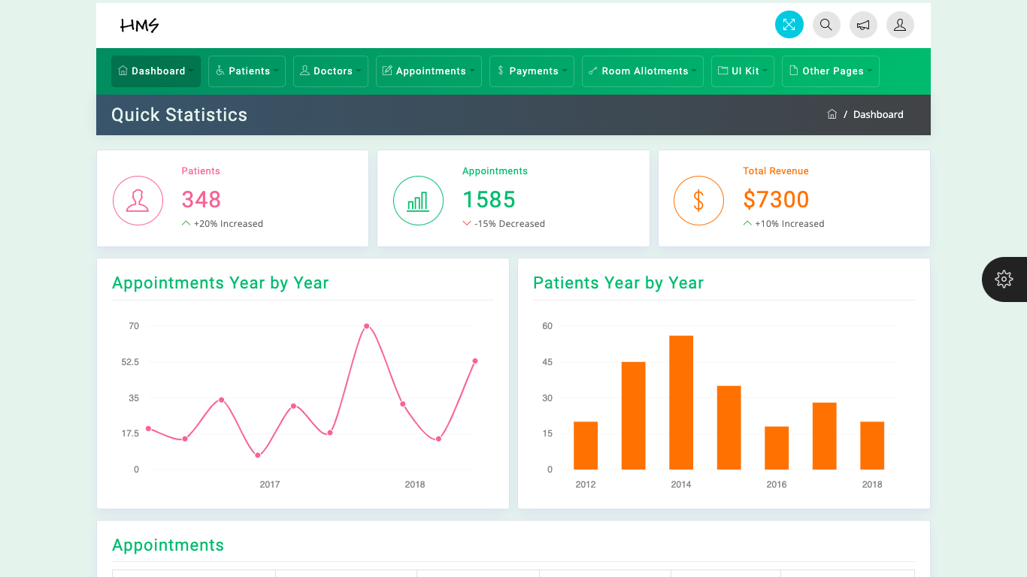
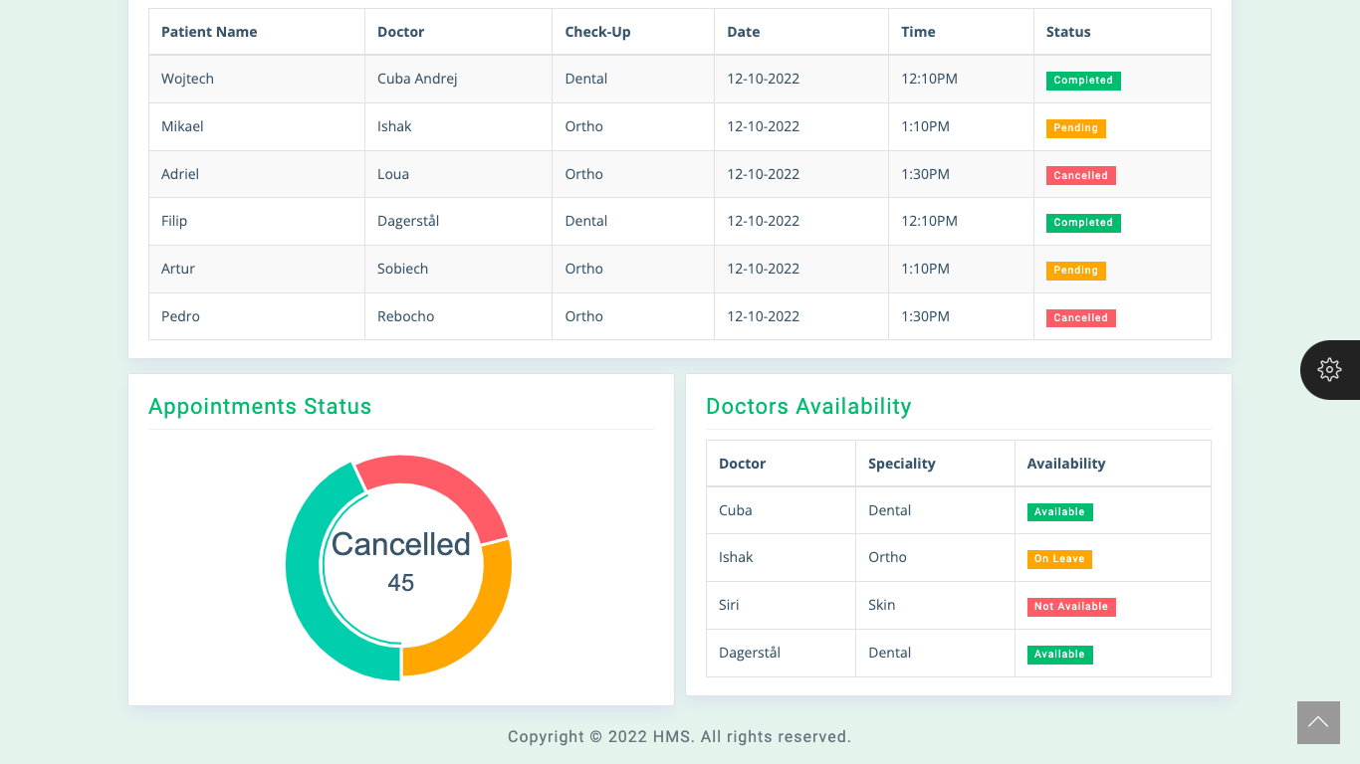
1. Statistics/Dashboard
Here we can check statistics of the hospital over a period of time.

Slide 7
1. Patients Module
Add Patient
All Patient
PATIENT
Patient details
Edit Patient

Slide 8
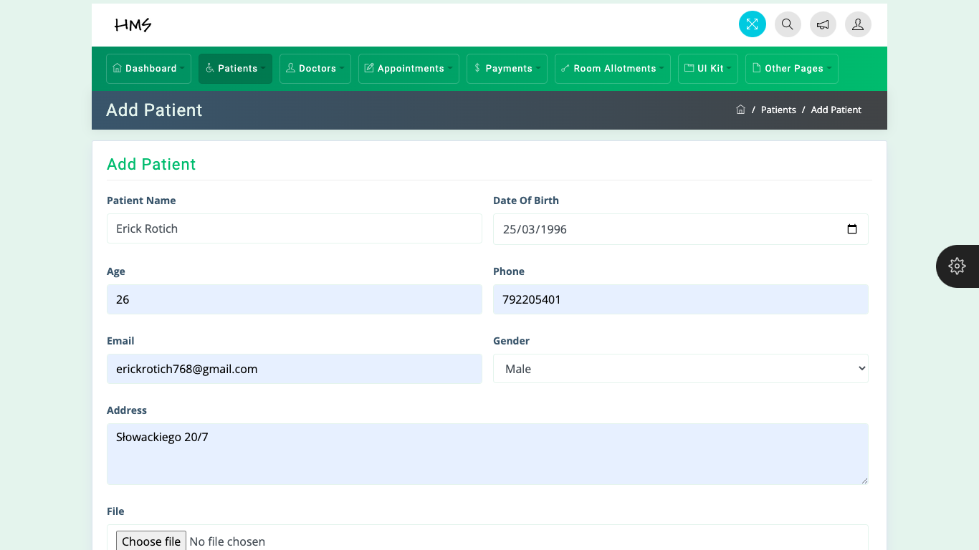
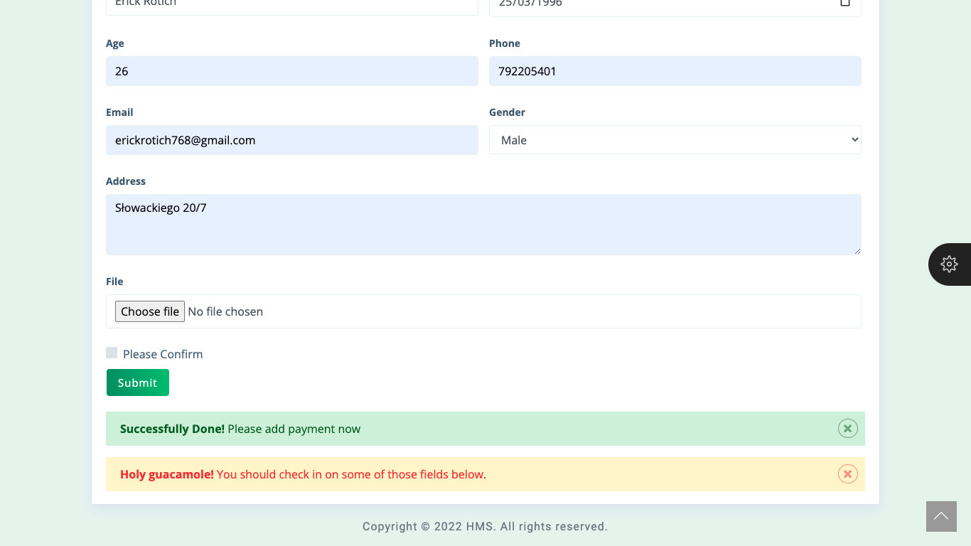
2. Patients
2.1 Add patient.
Add patients details

Slide 9
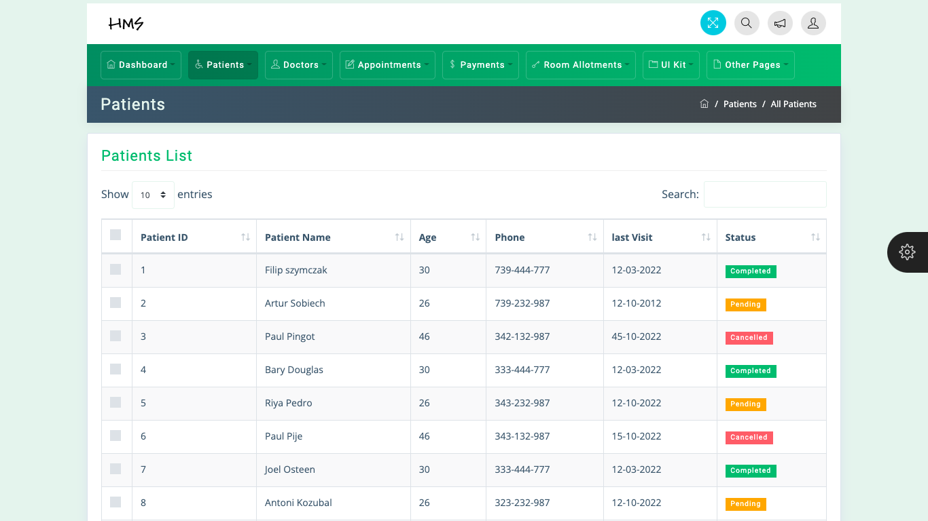
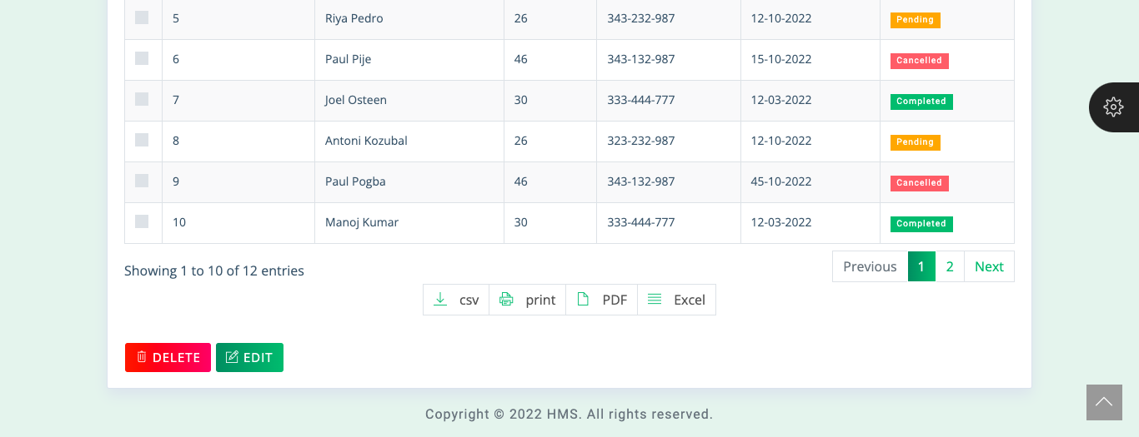
2. Patients
2.2 All patient.
Here we can check list of all patients.
We can delete or edit details.
We can print or download.

Slide 10
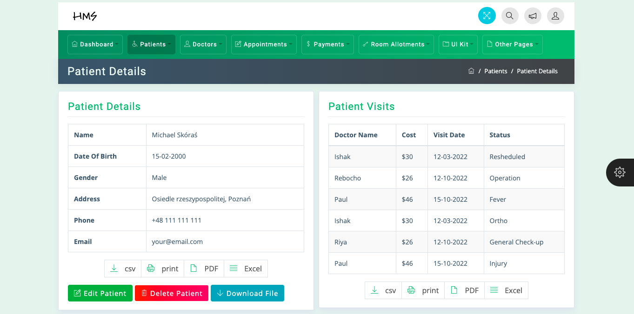
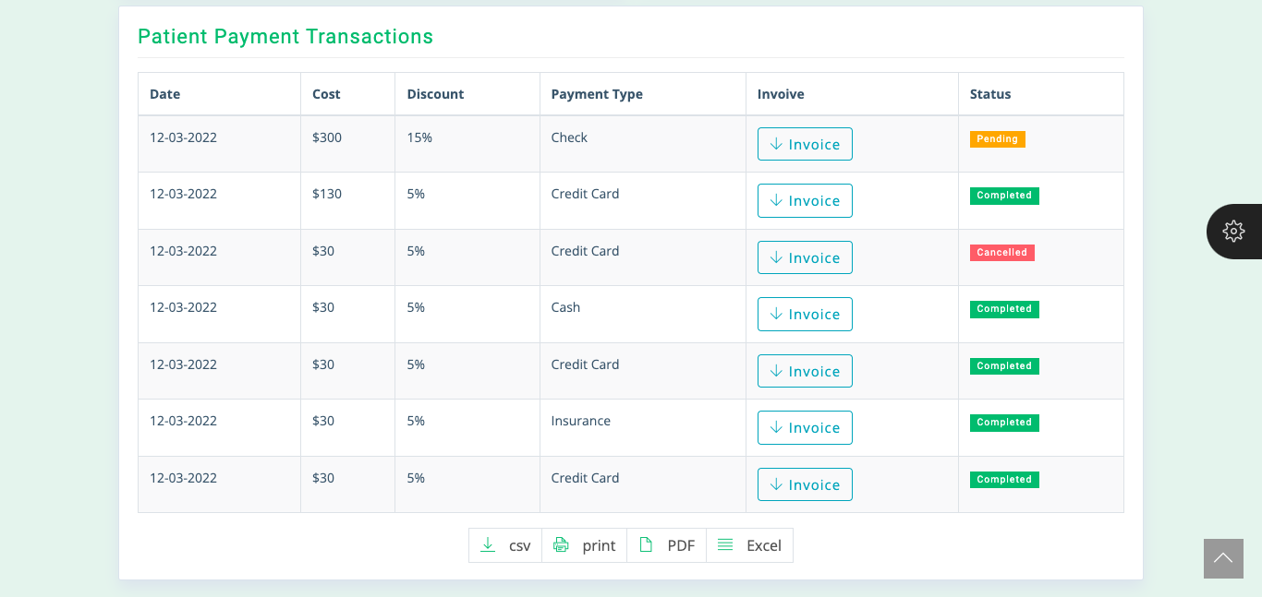
2. Patients
2.3 Patient details.
We can see patients details.
Patients visit.
Patients payment transactions.
We can delete, edit or download details.

Slide 11
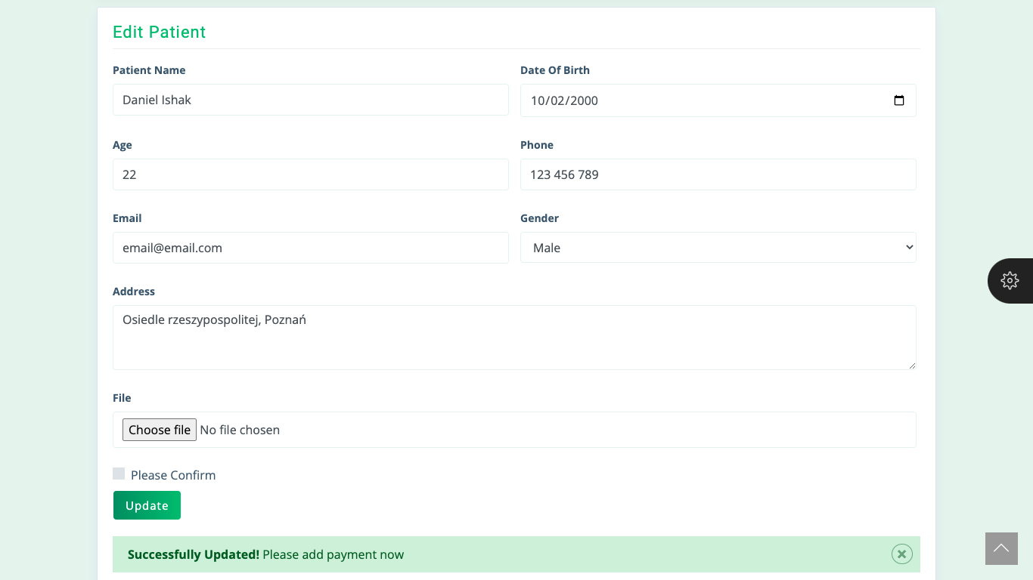
2. Patients
2.4 Edit patient.
Update patients details.

Slide 12
2. Doctors Module
Add Doctor
All Doctor
DOCTOR
Doctor details
Edit Doctor

Slide 13
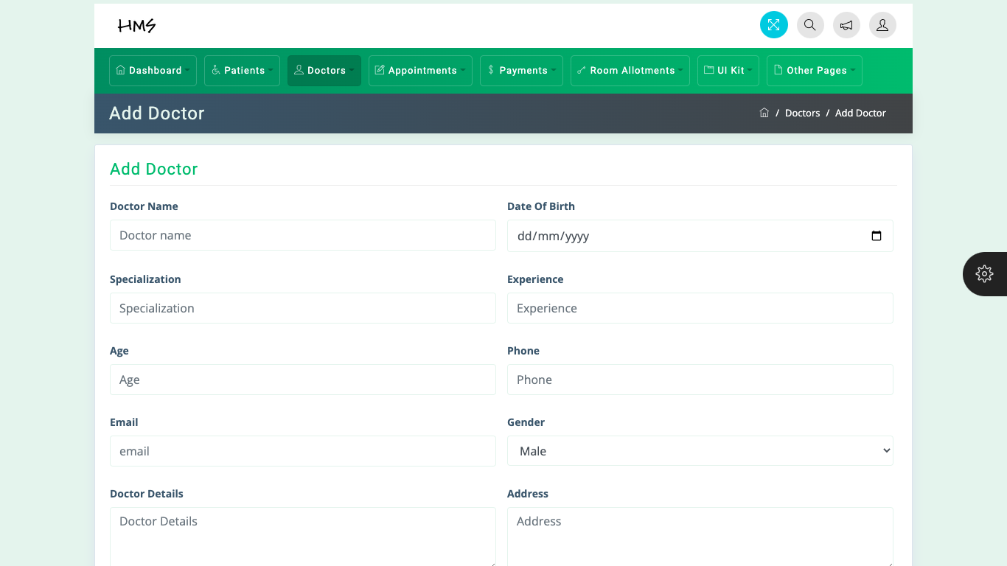
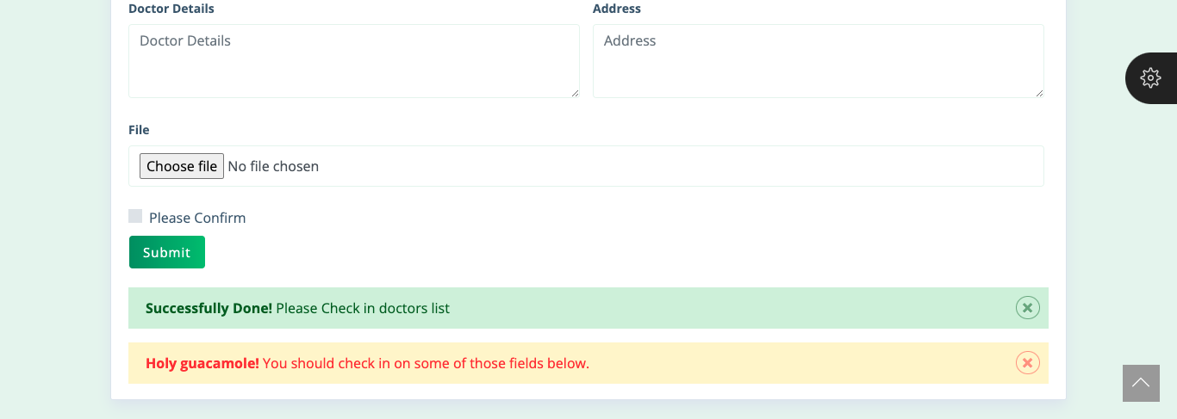
3. Doctors
3.1 Add doctor.
We can add a new doctor into the system.

Slide 14
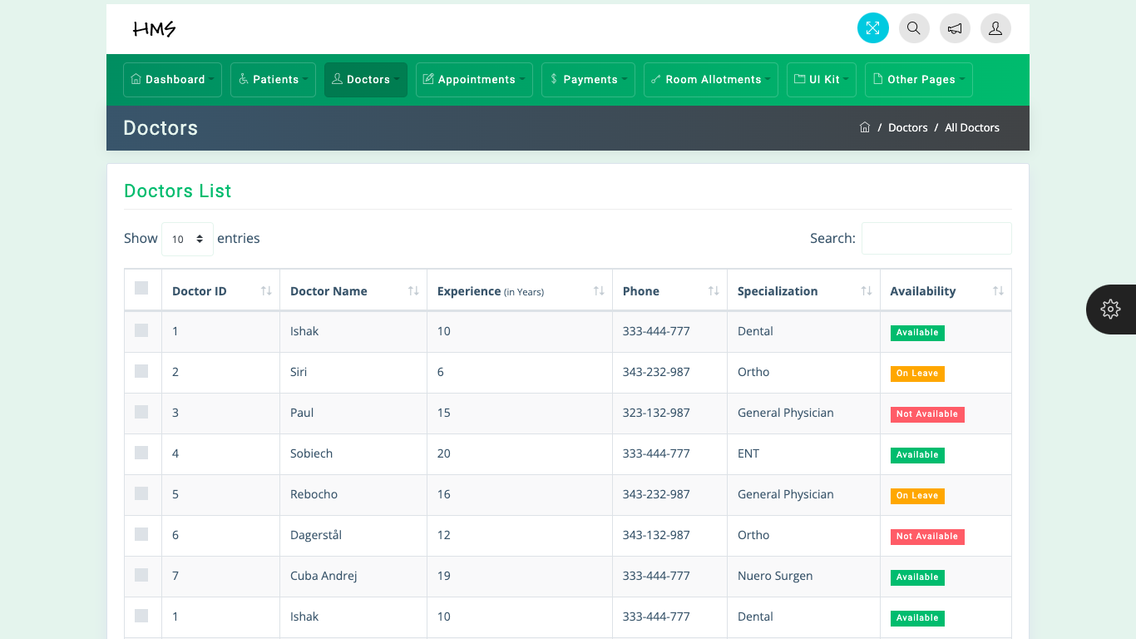
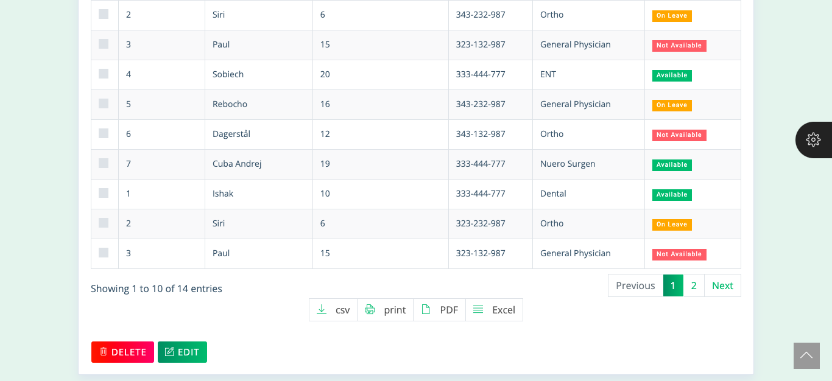
3. Doctors
3.2 All doctor.
List of all doctors.

Slide 15
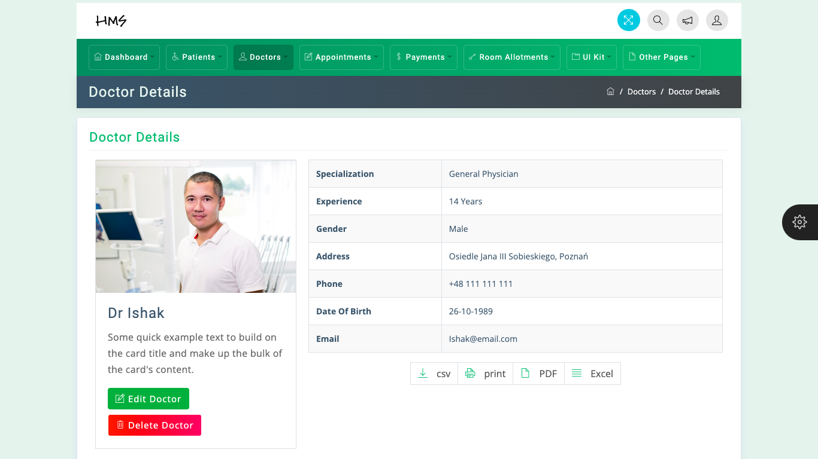
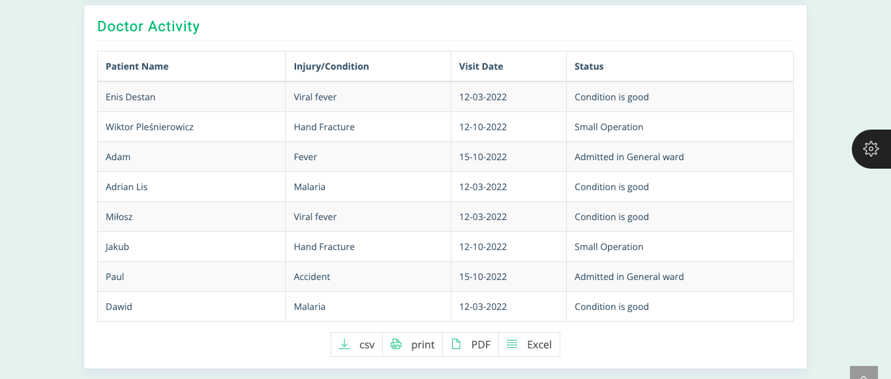
3. Doctors
3.3 Doctor details.
Details about the doctor.
Patients activities.

Slide 16
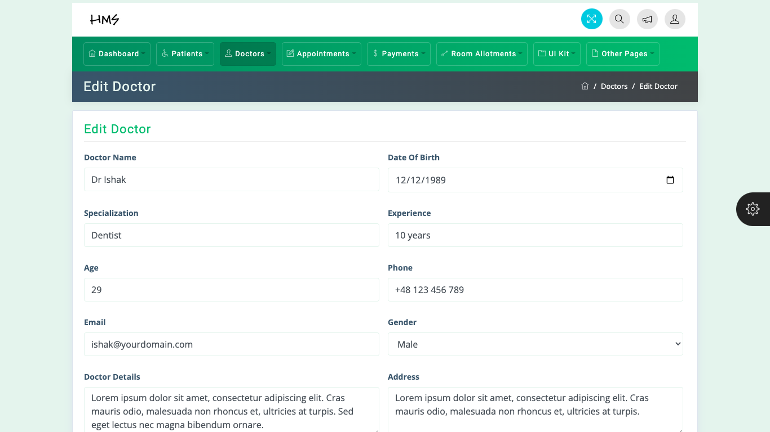
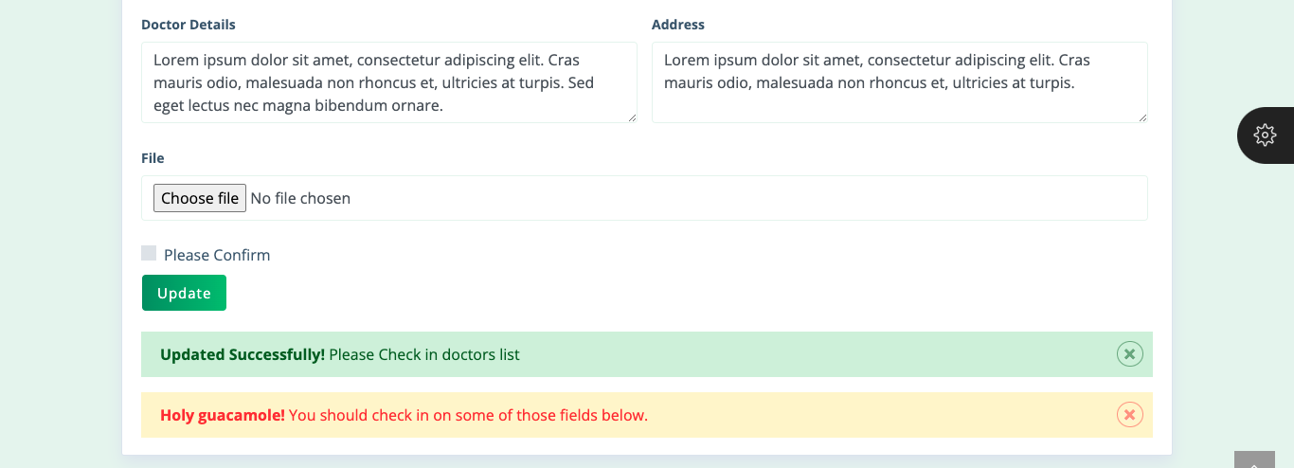
3. Doctors
3.4 Edit doctor.
Edit doctors details

Slide 17
3. Appointment Module
Add Appointment
All Appointment
APPOINTMENT
Appointment details
Edit Appointment

Slide 18
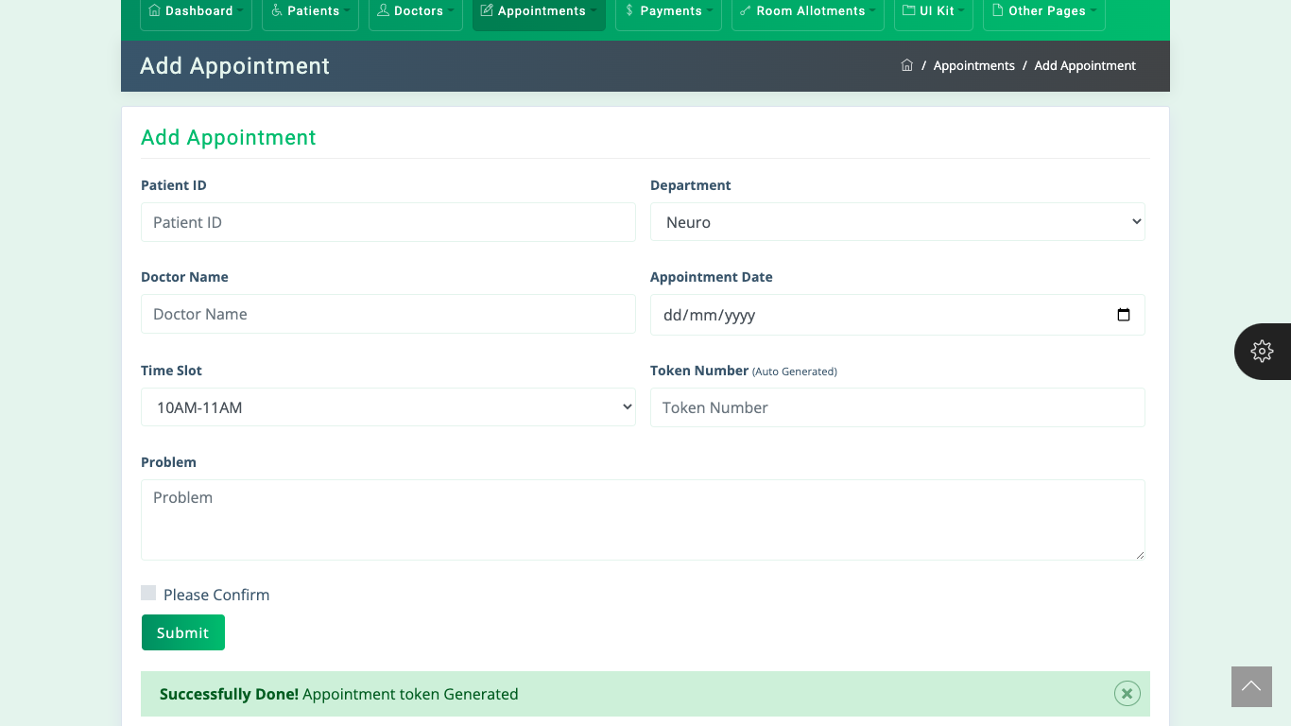
4. Appointments
4.1 Add Appointment.
Here you can schedule patients appointment.
Appointment alerts will be sent to patients.
Doctors scheduling.

Slide 19
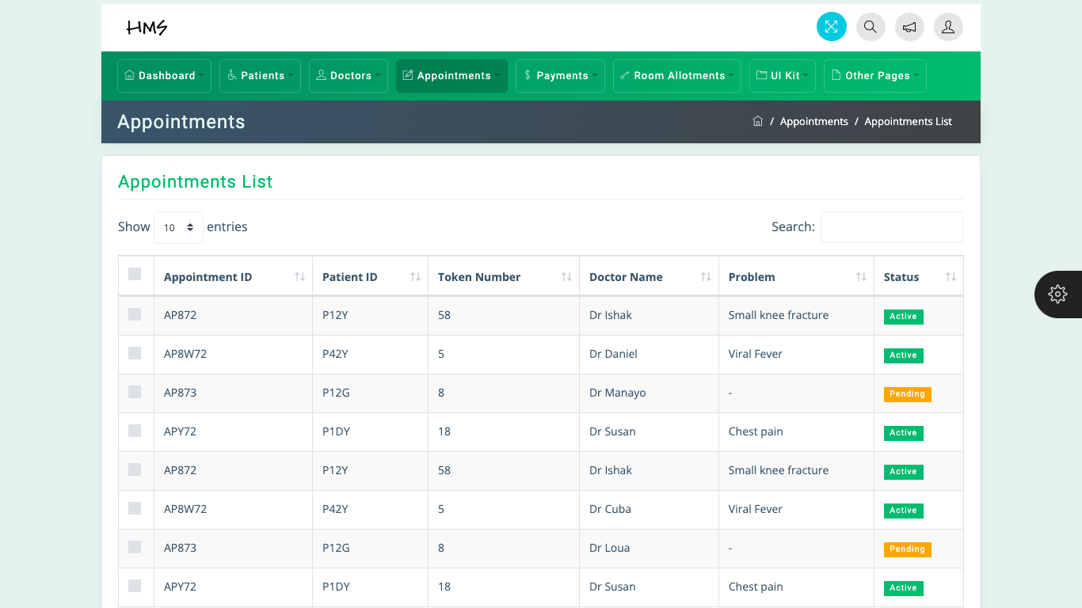
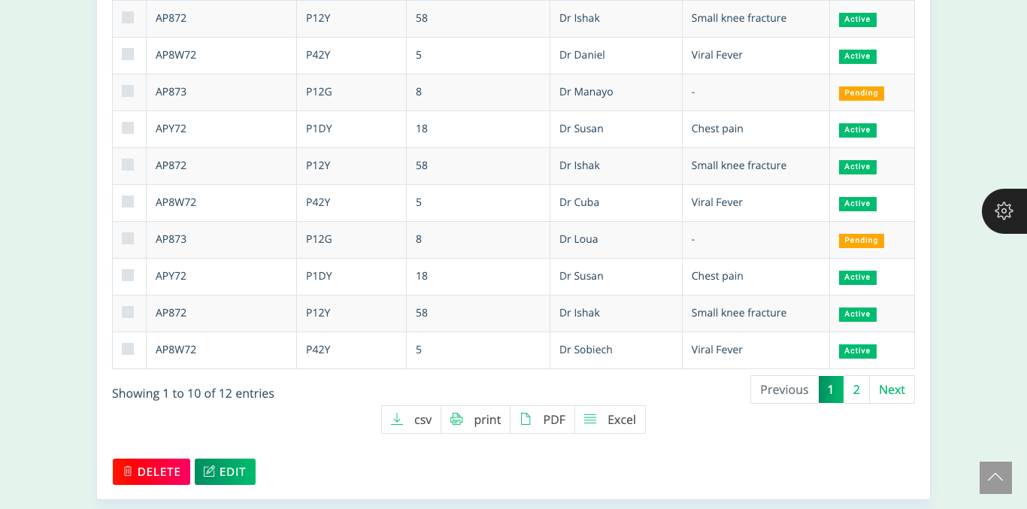
4. Appointments
4.2 All Appointment.
List of all appointments.

Slide 20
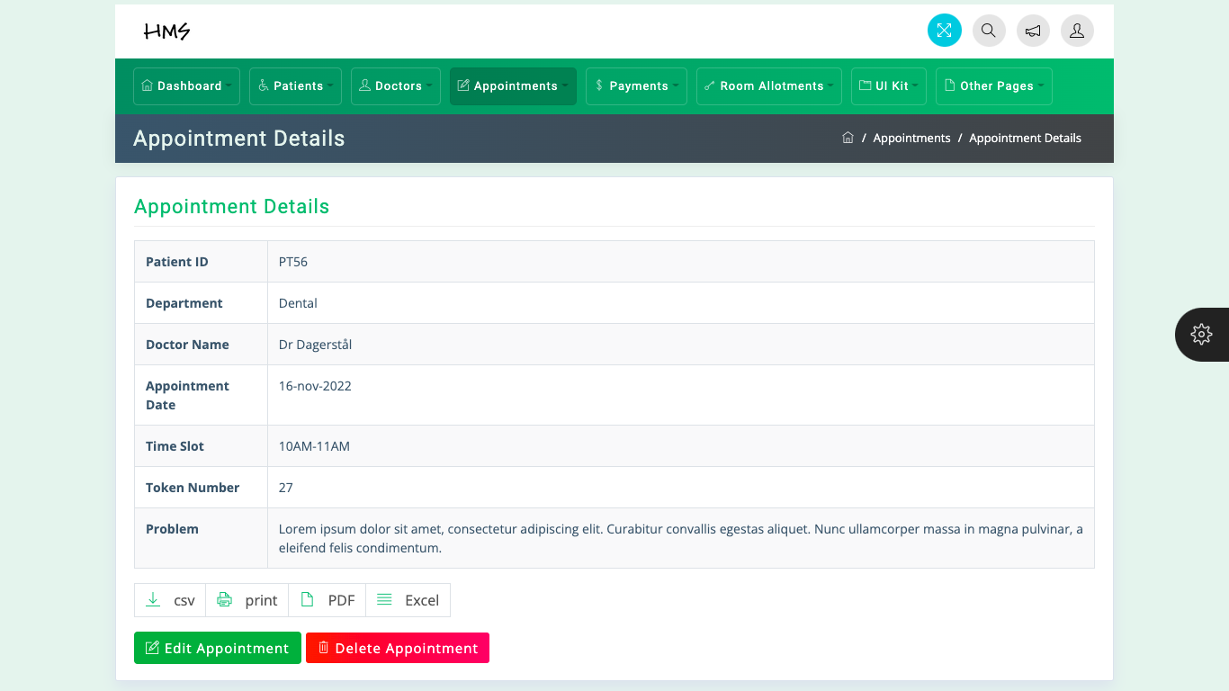
4. Appointment
4.3 Appointment details.
Here we can check appointment details.

Slide 21
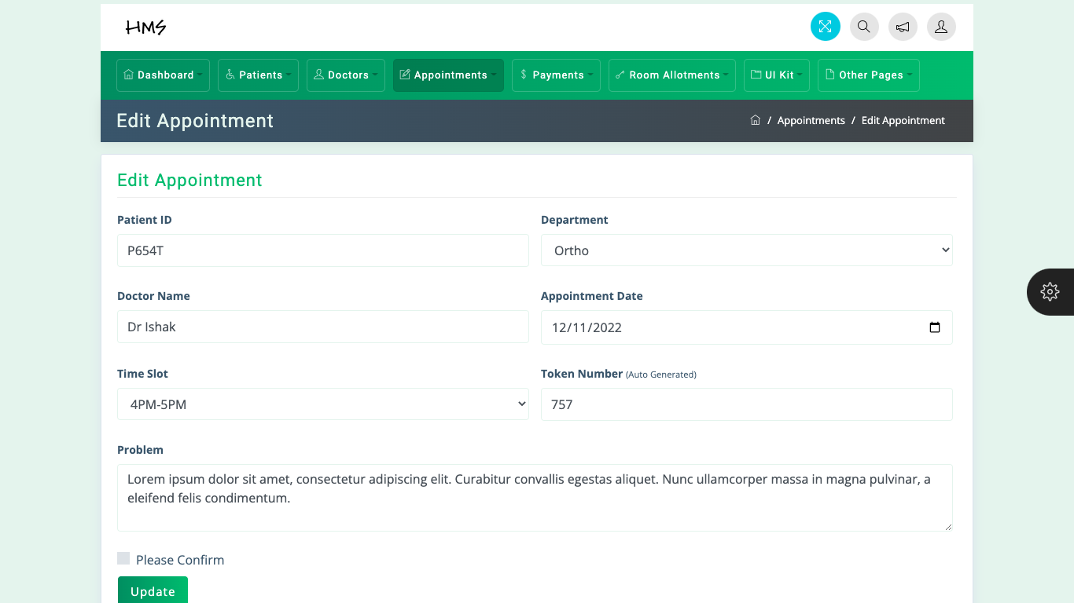
4. Appointment
4.4 Edit Appointment.
Here we can edit appointments.

Slide 22
4. Payments Module
Add payments
PAYMENTS
All payments
Payment invoice

Slide 23
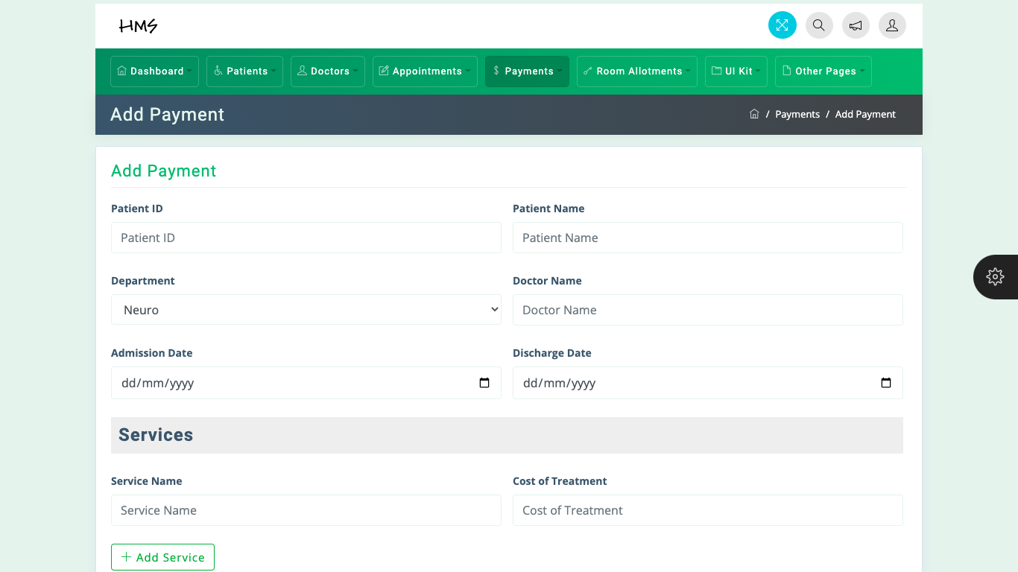
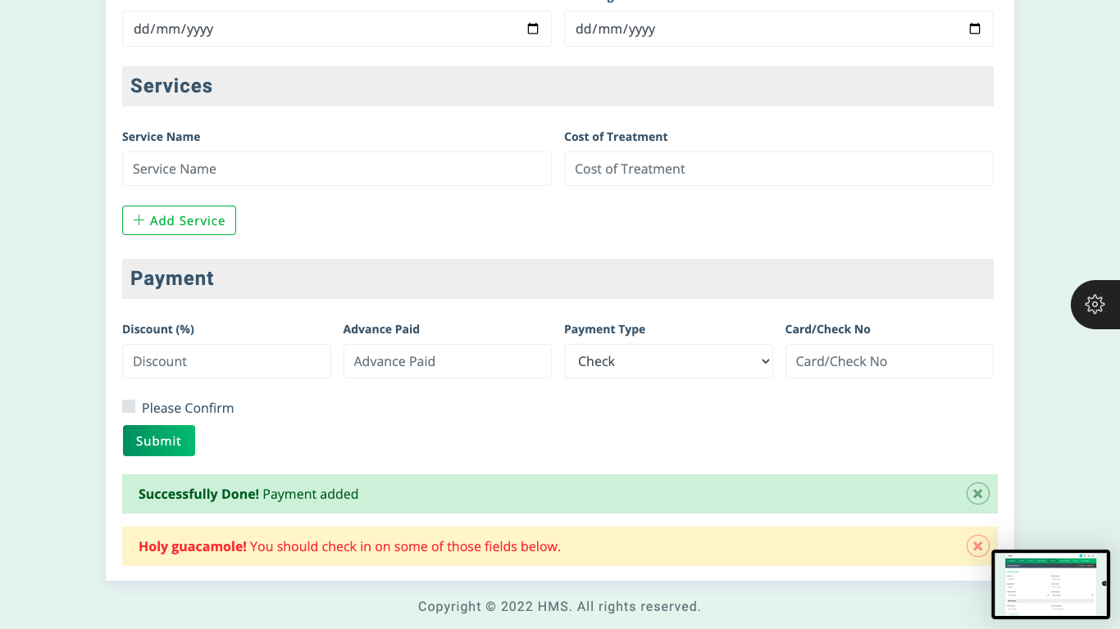
5. Payments
5.1 Add payments.
Here we can add payments.
Can choose service type
Can choose payment discount.
Can choose the payment type.

Slide 24
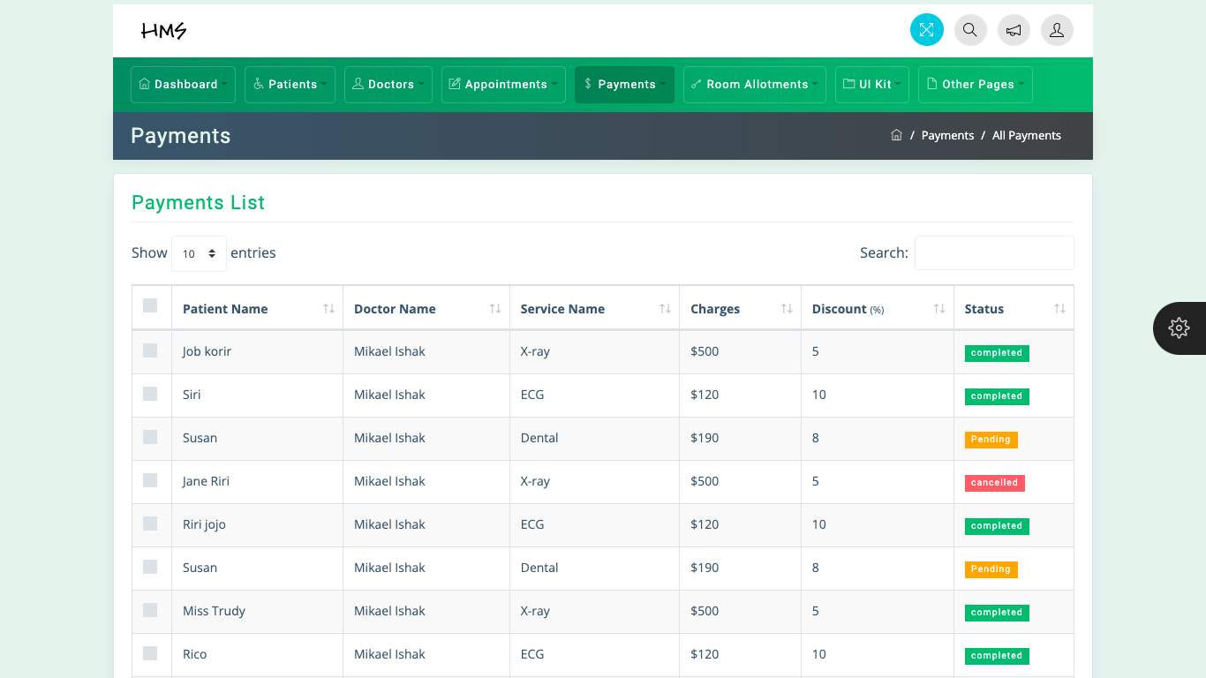
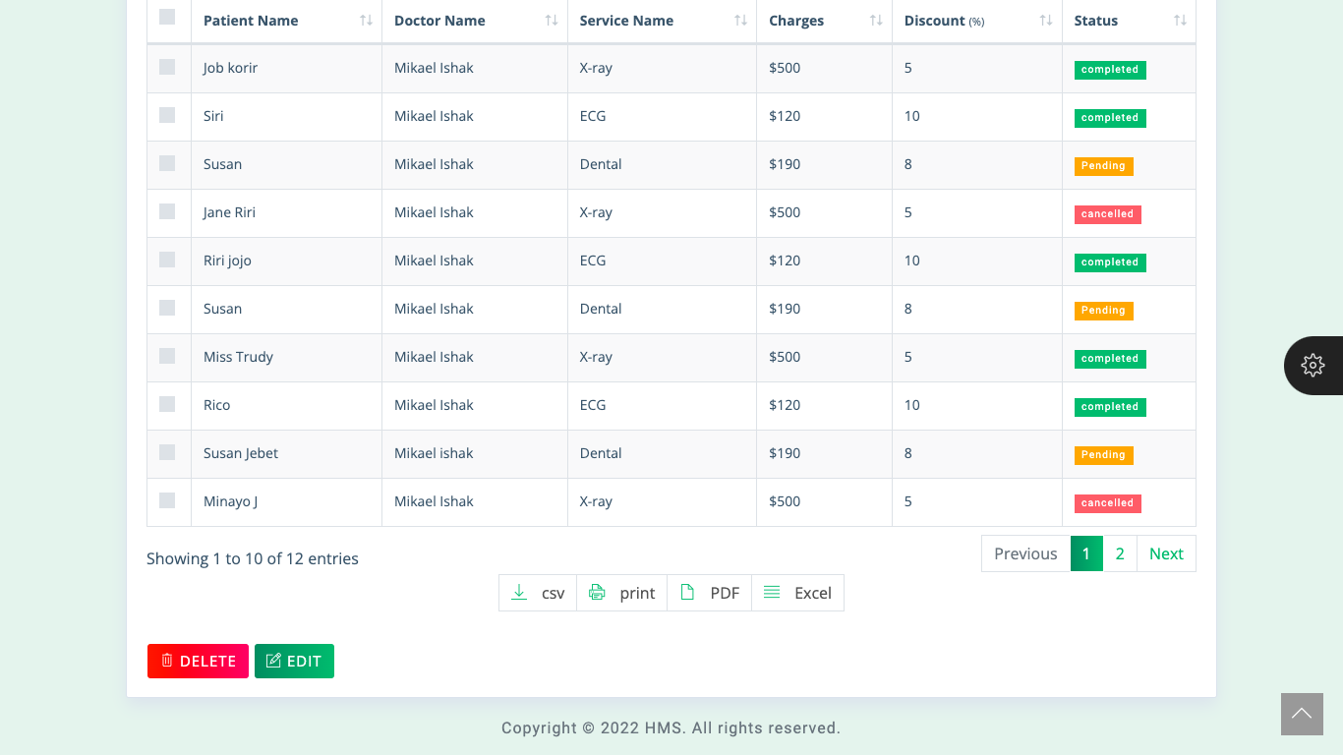
5. Payments
5.2 All payments.
Here we can check the list of all payments.
We can see the services provided, the discounts, the total price the doctor and status of payment.
We can also print or download.
We can also delete and edit.

Slide 25
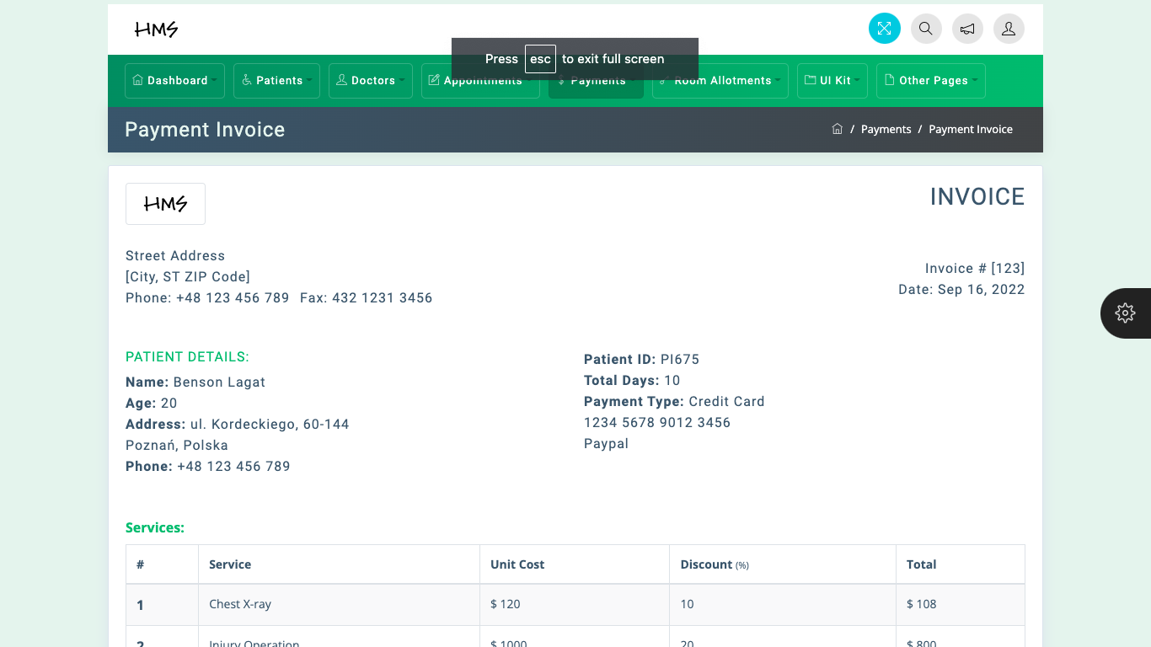
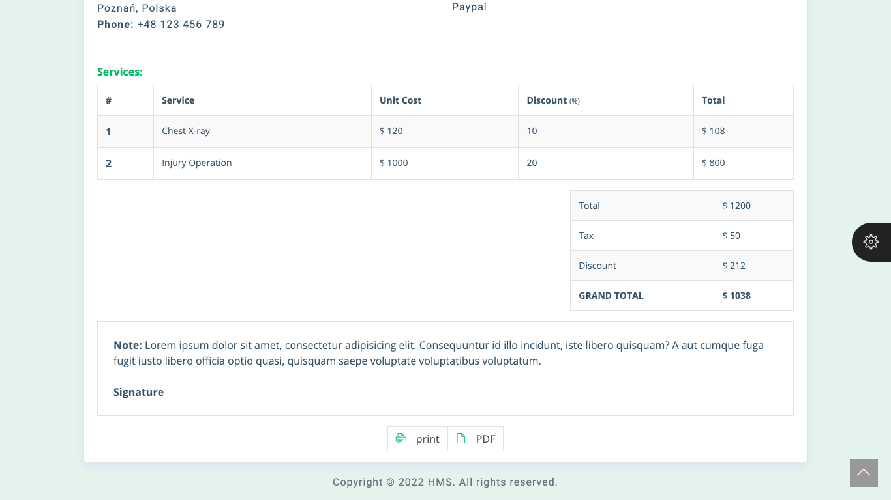
5. Payments
5.3 Payment invoice.
Here we can check our invoice.
We can print it or download a pdf copy.

Slide 26
Conclusion
The project Hospital Management System (HMS) is for computerizing the working in a hospital. The software takes care of all requirements of an average hospital and is capable to provide easy and effective storage of information related to patients that come up to the hospital.
It generates test report, as well as prescription details prescribed to patients. It also provides billing facilities whether it is an indoor or outdoor patient.

Slide 27

Thank You!

